Slide 1
CS 4350: Fundamentals of Software Engineering CS 5500: Foundations of Software Engineering Lesson 7.3 Code Reviews
Jonathan Bell, Adeel Bhutta, Ferdinand Vesely, Mitch Wand
Khoury College of Computer Sciences
© 2022 Released under the CC BY-SA license

Slide 2
Learning Objectives for this Lesson
By the end of this lesson, you should be able to:
Articulate what a code review is;
List the roles of people in code reviews;
Explain an appropriate time for code reviews;
Illustrate one way to hold a code review;
Describe the benefits of a culture of code review.

Slide 3

Linus’s Law motivates Code Review
Given enough eyeballs,
all bugs are shallow
Coined by Eric Raymond in honor of Linus Torvalds.
“Mantra” of Open-Source Movement
(pace “Heartbleed”, and others.)

Slide 4
Code Should be Read, not Just Run
Requirements and design documents are usually read by multiple people - who often didn’t write them
There are meetings, discussions
Customers, managers, developers, Q&A provide input
Should code get released having been read just by its author?
Think of books: nothing is commercially published without scrutiny and input from editors

Slide 5
Code Inspection is Heavier Weight
Formal process of reading through code as a group;
Applied to all project documents;
A 3-5 person team reads the code aloud and explains what is being done;
Each person has a specific role (moderator, reviewer, reader, scribe, observer, author)
Note, the author does not present their code
Usually a 60 minute meeting;
Less efficient (defects/cost) than modern review processes.
Very waterfall.
Traceable, measurable
Notes:
A formal code inspection is a heavyweight process, usually called for by strict standards and there’s a detailed paper trail to be produced.

Slide 6
Code Review: What
A code review is the process in which the author of some code is asked to explain it to their peers:
What purpose the code has;
How the code accomplishes this purpose;
How the author is confident of this information,
E.g., show results of running tests.
A code review often concerns a code change.
A code review doesn’t assume anything is wrong.
A code review isn’t “selling” the code.
See Chapter 9 in SoftEng @ Google

Slide 7
Code Review: Who
The author of the code is the presenter.
An owner of the code being changed or added to
May sometimes be the same person as presenter.
Someone to verify that the code meets standards.
Someone to ensure documentation is consistent.
Other people:
Interested in this code base;
Experts in the code base.
SE@Google:
At least one person other than author

Slide 8
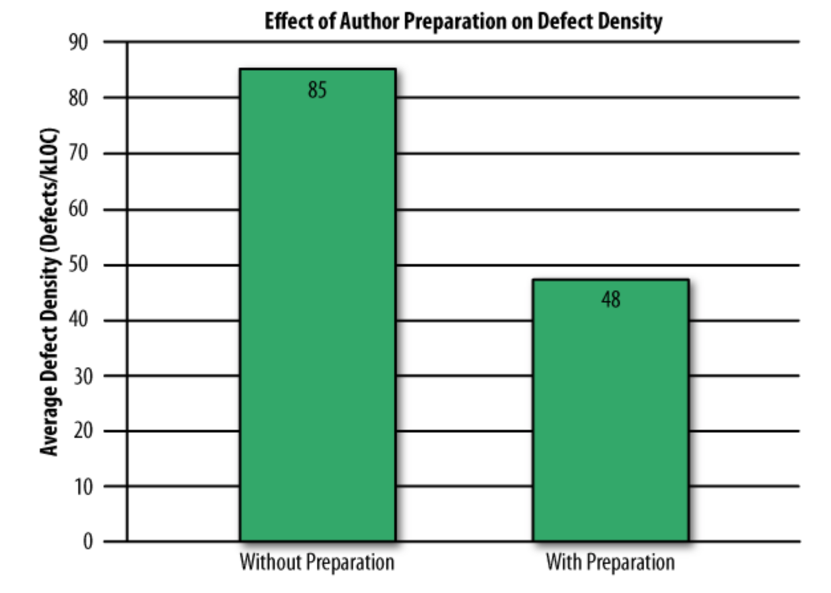
Self-Review Less Effective than Peer Review
Study of 300 reviews at Cisco in 2006
Even if developers pre-review their code, many defects still found in peer review
“Best Kept Secrets of Peer Code Review”, Jason Cohen, SmartBear Software, 2006
Notes:
Study compared code reviews that had been previously reviewed by the author (“with preparation”) from those where authors claim to have not done any self-review (“without preparation”)

Slide 9
Code Review: When
SE @ Google recommends reviews at commit:
Every commit must be reviewed;
Best time to ensure code is good:
Once code is in production, hard to justify;
Before code is ready to use, review superfluous.
Reviews need to be done quickly.
Code review for new developers:
Helps them understand standards;
Code review of established code:
Spread understanding of algorithms/techniques.

Slide 10
Code Review: How
At Google, reviewers get access to changes, explanation and all relevant test results: review is asynchronous.
Elsewhere reviews can be in person:
More heavyweight, cannot be as common.
Review must be professional and impersonal:
No one is being “attacked” (or, no one should be).
Don’t rehash design arguments (defer to author).
All suggestions and criticisms must be addressed:
At least in the negative.

Slide 11
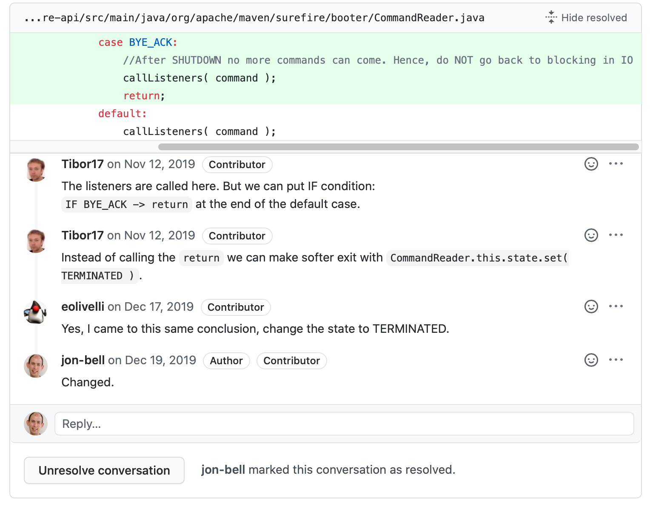
Code Review: Example on Pull Request
Notes:
Here’s an example of a code review on a pull request. The pull request model encourages project maintainers to review a pull request (patch) being submitted. Code review interfaces like GitHub’s make clear who is the author of the code, and who is otherwise a contributor to the repository.

Slide 12
Code Review: Sample Check-List
Am I able to understand the code easily?
Does the code follow our style guidelines?
Is the same code duplicated more than once?
Is this file (or change) too big?
Does this code meet our non-functional requirements?
Is this code maintainable?
Does this code have unintended side-effects?

Slide 13
Code Review: Why
Code review increases breadth of knowledge of code:
Other people ”know” the code;
Easier to handle someone cycling off project.
Verbalizing decisions improves their quality:
The process of writing an explanation encourages critical thinking.
Code reviews improve quality of code base:
Knowing code will be reviewed pushes developers to make code more presentable and understandable.

Slide 14
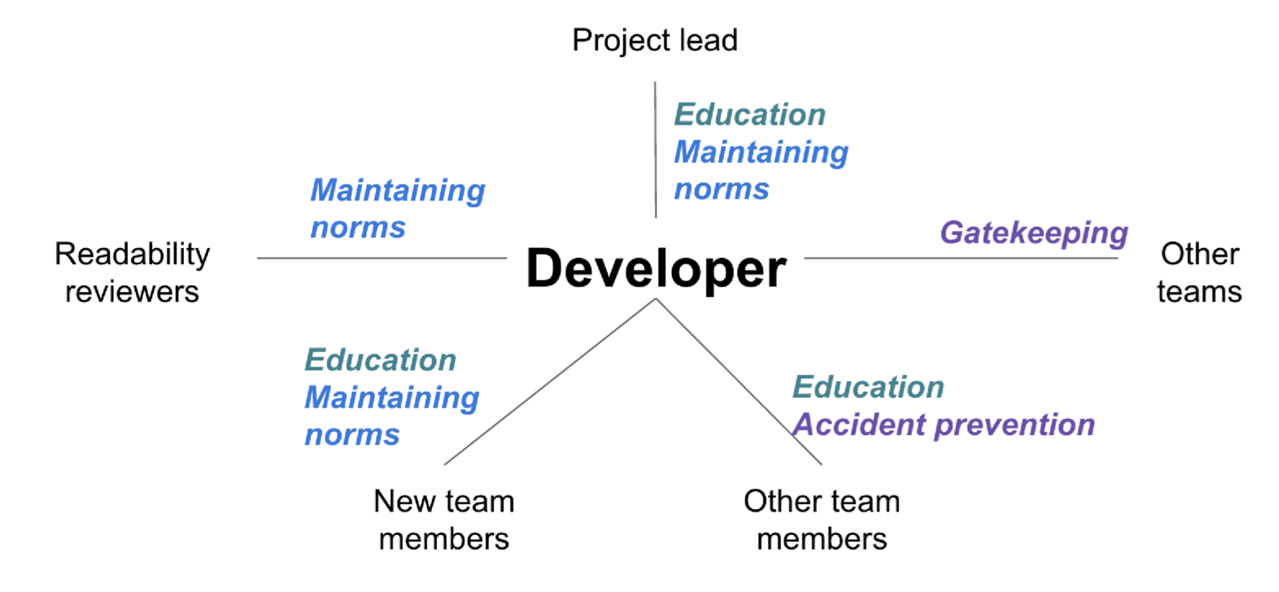
Code Review: Why (Google)
Different team members have different motivations and bring different benefits
“Modern Code Review: A Case Study at Google”, Sadowski et al, ICSE 2018
Notes:
Original motivation: “force developers to write code that other developers could understand”
Found many other benefits, depending on the role of the team member.
(read slide – black text is the roles, color coding shows the same goal/benefit)

Slide 15
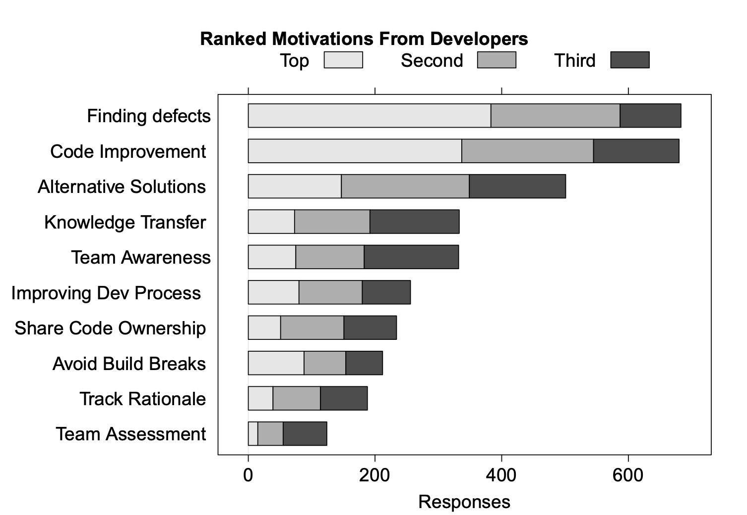
Code Review: Why (Microsoft)
“Expectations, Outcomes, and Challenges of Modern Code Review”, Bacchelli & Bird, ICSE 2013
Notes:
Check code quality attributes that are hard to automatically check: security, compliance, scalability

Slide 16
A Note on Programmer’s Ego
Someone looking over your work
Probably some attachment to it
Criticisms: sometimes hard not to take personally
Acknowledge a criticism and move on
Acknowledgment doesn’t imply that the author agrees with the content of the criticism
Author should not try to defend the work under review

Slide 17
Review: Learning Objectives for this Lesson
You should now be able to:
Articulate what a code review is;
List the roles of people in code reviews;
Explain an appropriate time for code reviews;
Illustrate one way to hold a code review;
Describe the benefits of a culture of code review.

Slide 18
Looking Forward...
In our next lesson, we’ll discuss other approaches for ensuring software quality: Analysis and verification.

